Slide 1
Piter Garcia Color Histogram Descriptor
Update Report – Week 2

Slide 2
Work Done & In Progress
Formulating Algorithm - Image Representation:
In this section we describe the:
- color feature spaces
- texture feature spaces
- representation of distributions (in these spaces).
Color:
- the perceived differences between individual nearby colors
- implement the Euclidean distances between the color coordinates.
Texture: Color is a purely pointwise property of images;
- involves a notion of spatial extent, a single point has no texture.
- Frequency-domain texture descriptors refer instead to the frequency;
content in a local neighborhood of the point.

Slide 3
Work Done & In Progress
Obtaining and Analysing Bin Information
- feature selection
- image indexing
- retrieval
- pattern classification
- clustering.
Histogram Measure Methods:
Implementation & Comparison

Slide 4
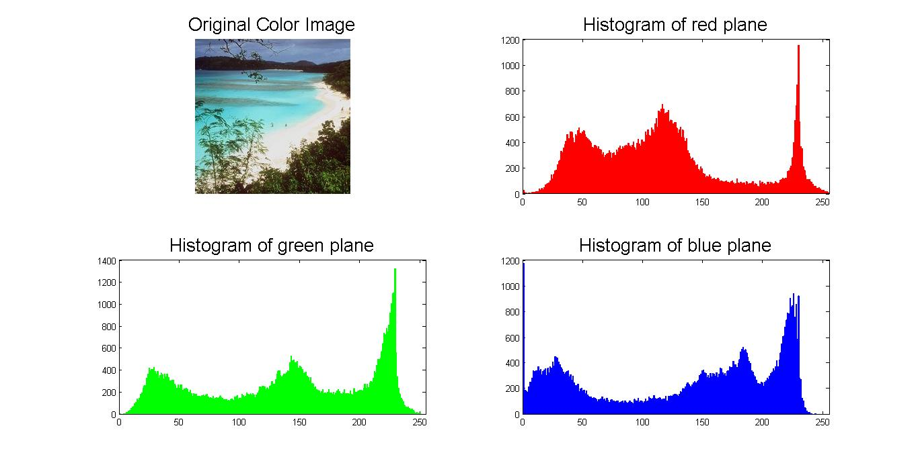
Previously

Slide 5
Combining Histograms
function newImg = rgb2lst(img)
img = imread('OrangeFlower.jpg');
newImg = uint8(zeros(size(img)));
alpha = 1;
lstMat =[ alpha/sqrt(3), alpha/sqrt(3), alpha/sqrt(3); alpha/sqrt(2), 0,-alpha/sqrt(2); alpha/sqrt(6), 2*alpha/sqrt(6), alpha/sqrt(6)];
%slow but steady
for rowi = 1:(size(img,1))
for coli = 1:(size(img,2))
alpha = 255/max([img(rowi,coli,1),img(rowi,coli,2),img(rowi,coli,3)]);
IstMat =[ alpha/sqrt(3), alpha/sqrt(3), alpha/sqrt(3);alpha/sqrt(2), 0, -alpha/sqrt(2); alpha/sqrt(6), 2*alpha/sqrt(6), alpha/sqrt(6)];
newImg(rowi, coli,:) = uint8(double(lstMat)*double([img(rowi,coli,1);img(rowi,coli,2);img(rowi,coli,3)]));
end
end

Slide 6
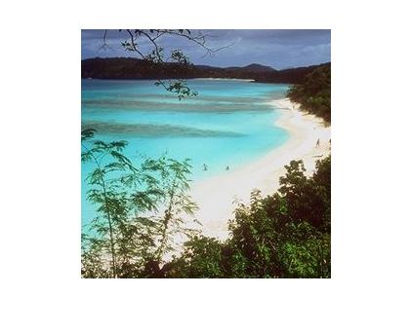

Slide 7
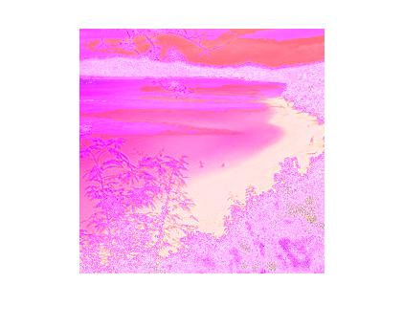

Slide 8
Combining Histograms
function threeDimHist = rgbhist(I,show)
%RGBHIST Histogram of RGB values.
if (size(I, 3) ~= 3)
error('rgbhist:numberOfSamples', 'Input image must be RGB.')
end
%change manually
nBins = 16;
rHist = imhist(I(:,:,1), nBins);
gHist = imhist(I(:,:,2), nBins);
bHist = imhist(I(:,:,3), nBins);

Slide 9
threeDimHist = cat(2,rHist, gHist);
threeDimHist = cat(2,threeDimHist, bHist);
%varargout = rHist;
if(show == true)
figure;
hold on
stem(1:nBins, rHist,'-r');
stem(1:nBins + 1/3, gHist,'-g');
stem(1:nBins + 2/3, bHist,'-b');
hold off
end;

Slide 10
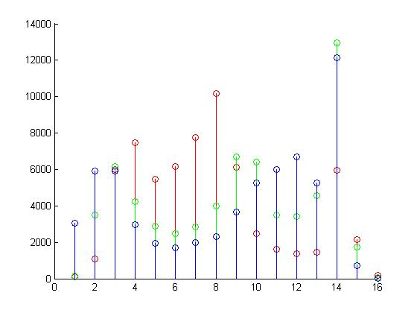

Slide 11
Bin Info & Comparison
threeDimHist =
102 157 3063
1093 3499 5928
6006 6171 5914
7456 4224 2955
5468 2874 1945
6179 2465 1695
7756 2864 1968
10188 3977 2315
6123 6686 3676
2458 6396 5245
1598 3511 6016
1351 3423 6691
1442 4549 5257
5968 12962 12143
2151 1721 724
197 57 1

Slide 12
Testing Methods and Comparison
function d = CommonDist(X1,X2,dist_type)
switch dist_type
case 'L1'
d = sum(abs(X1-X2));
case 'HI'
d = sum(min(X1,X2));
case 'Chi-square'
d = sum(((X1-X2).^2)./((X1+X2)+1e-10));
case 'BRD'
tmp1 = abs(1-X1*X2');
tmp2 = ((X1-X2).^2 + 2*tmp1*(X1.*X2))./((X1+X2).^2+1e-10);
d = abs(sum(tmp2));

Slide 13
Testing Methods and Comparison
case 'L1-BRD'
tmp1 = abs(1-X1*X2');
tmp2 = ((X1-X2).^2 + 2*tmp1*(X1.*X2)).*abs(X1-X2)./((X1+X2).^2+1e-10);
d = abs(sum(tmp2));
case 'Chi-square-BRD'
tmp1 = abs(1-X1*X2');
tmp2 = ((X1-X2).^2 + 2*tmp1*(X1.*X2)).*(X1-X2).^2./((X1+X2).^3+1e-10);
d = abs(sum(tmp2));
otherwise
d = -1;
error('unknown dist type!');
end

Slide 14
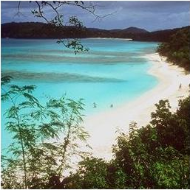
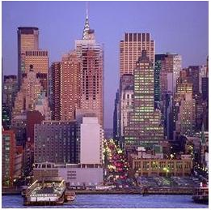
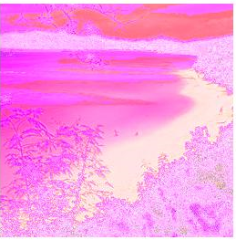
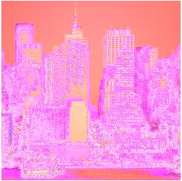
Comparing Coast & Tall-Building Classes

Slide 15
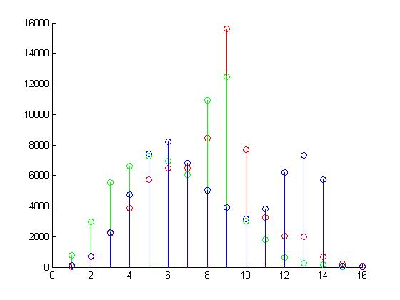
COAST COMBINED HISTOGRAM
TALL BUILDING COMBINED HISTOGRAM

Slide 16
Comparison of Two Histograms of Different Classes
ans = L1
36390 55684 47240
ans = HI
47341 37694 41916
ans = BRD
1.0e+012 *
0.8162 0.3536 1.4950
ans = L1-BRD
1.0e+014 *
1.1681 0.7481 0.5490
ans = Chi-square
1.0e+004 *
1.6805 3.2903 2.4200
ans = Chi-square-BRD
1.0e+013 *
6.1338 5.6304 4.1346

Slide 17
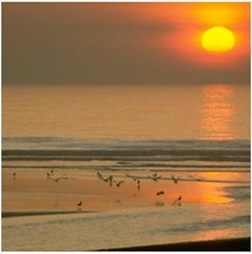
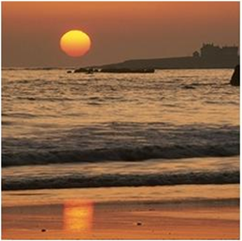
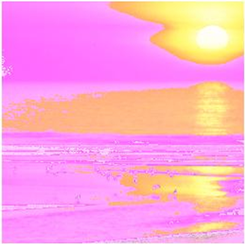
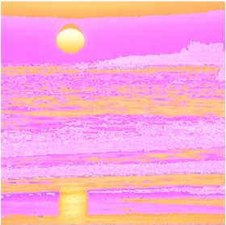
Comparing Coast & Coast Class

Slide 18
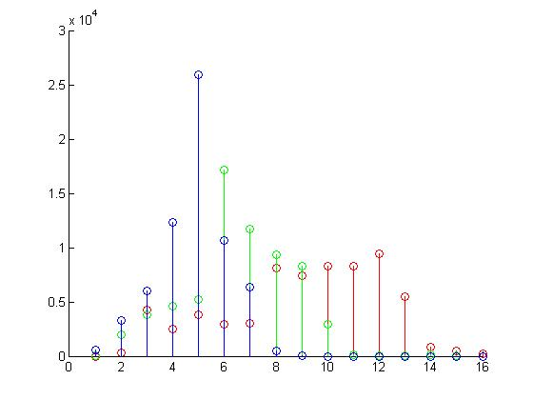
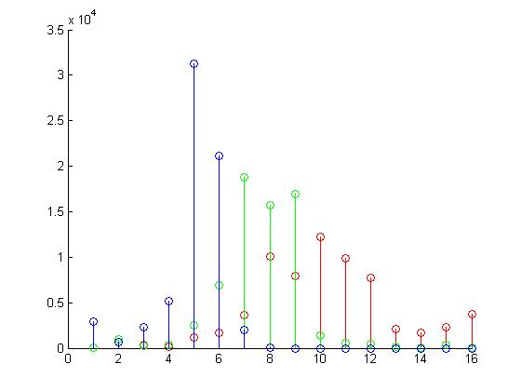
COAST COMBINED HISTOGRAM
COAST COMBINED HISTOGRAM

Slide 19
Comparison of Two Histograms of the Same Class
ans = L1
30388 46934 36462
ans = HI
50342 42069 47305
ans = BRD
0.0000 0.0000 1.1814
1.0e+014*
ans = L1-BRD
0.0166 0.0385 8.4154
1.0e+014 *
ans = Chi-square
1.4495 2.0363 1.4540
1.0e+004 *
ans = Chi-square-BRD
0.0143 0.0236 8.4091
1.0e+016 *

Slide 20
Next On The List
Feature Extraction Further Development
Individually, combine and average color histograms for each class
Set Comparison
Create a list of category of the average histograms of each class
Apply Class & Class feature comparison
Compare classes average histograms sets
- Classification Comparison
Verify and separate data
Average Intersection & Features Implementation
Check for intersecting features among classes
- Implement SVM

Slide 21
Project Flow Chart
Karina
Gabor Descriptor
Piter
Color Histograms Descriptor
Pauline
Centrist Descriptor
Hybrid Descriptor

Slide 22
Some Benefits of a Hybrid Descriptor
SCENE CATEGORIES
Gabor - Adds better texture
Color Histograms – More Robust to Cluttering & Normalization
Centrist – Adds better Visual and Object Recognition

